Slide 1

Payload Data Processing
BinarX Summer School2024

Slide 2

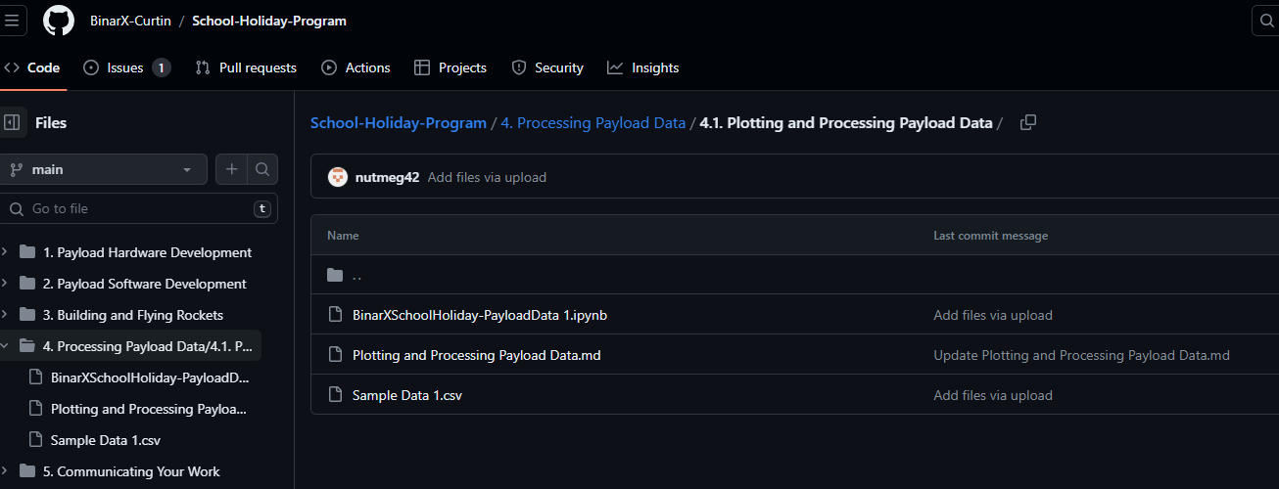
GETTING SET UP
Access to jupyter lab
jupyter.sstc.space
Create a user name and p/w
Make sure you record it!
Download “BinarXSchoolHoliday-PayloadData.ipynb” and “Sample Data.csv” from GitHub

Slide 3
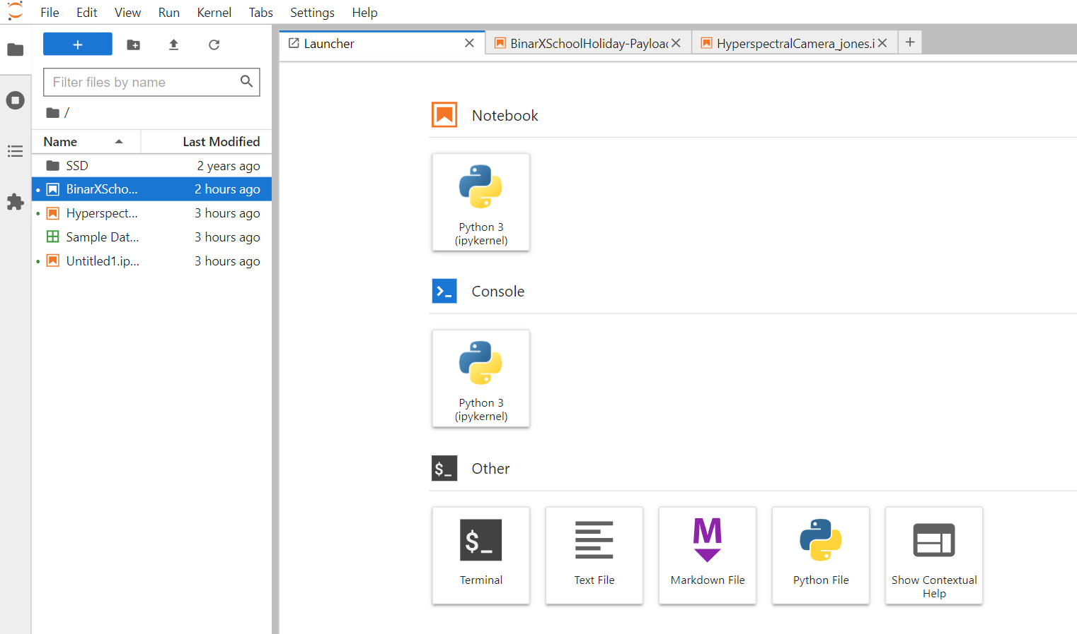
GETTING SET UP
Log into the online Jupyter server using your new user name and p/w
jupyter.sstc.space
Drag and drop the .ipynb and .csv files into the folder directory space on the server on the left-hand-side.
Drag your files into here. Double click to launch!

Slide 4
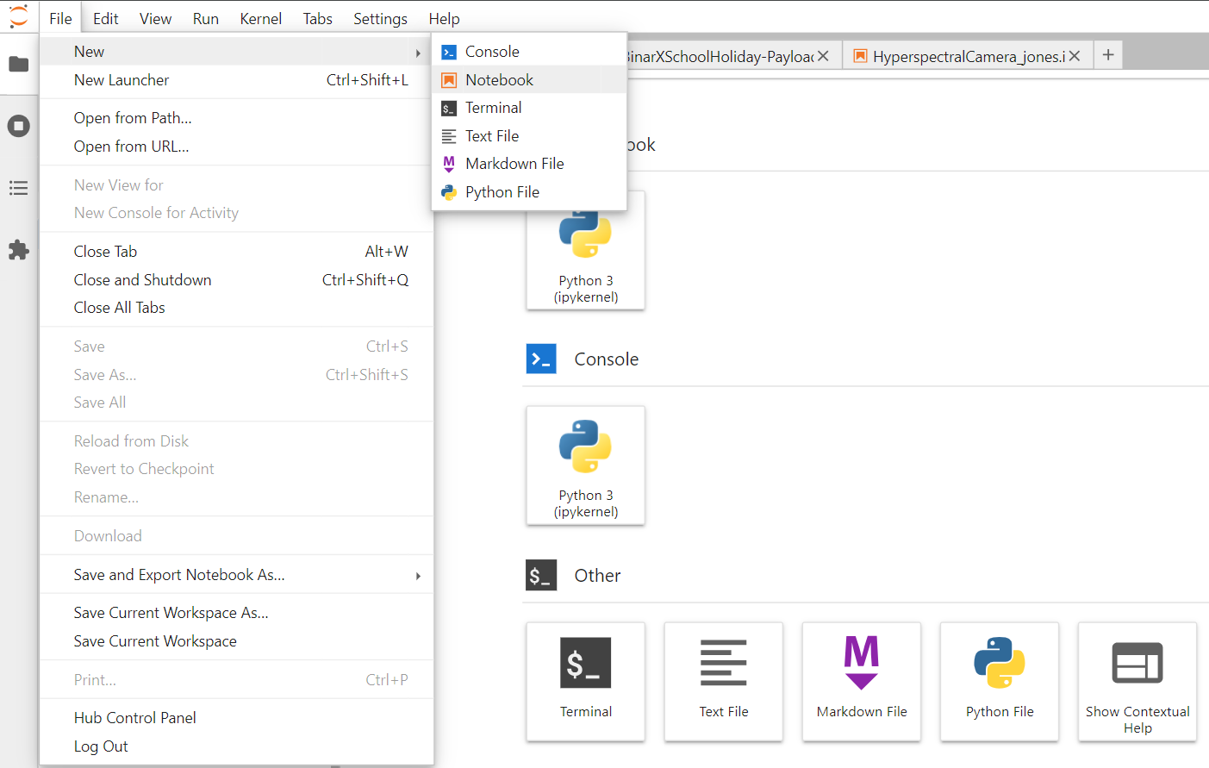
GETTING SET UP
Create a new empty python notebook for you to access, analyse and plot your payload data.
Name it “yourpayload_yourname.ipynb”

Slide 5
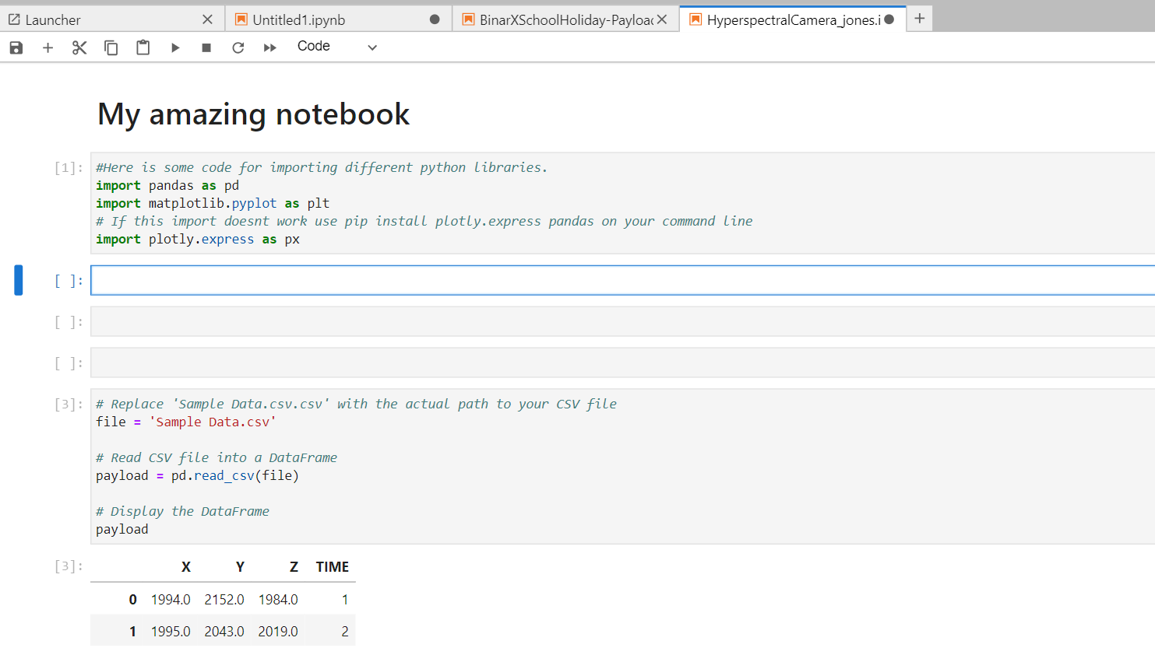
Running CODE
Copy code from here into your notebook.
Press this to run cells
Change cell type to from “Code” to “Markdown” to make it a text description or heading.
Blue cell is active. Type or paste in code.
Empty cells. Type or paste in code.
Press “shift-enter” to run cell and see the outputs

